Slide 1
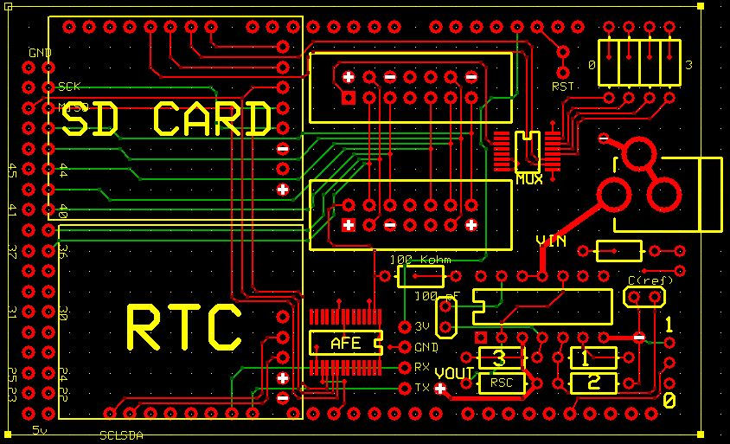
9
27
21
22
23
24
26
27
33
10
28
20
29
12
18
17
11
30
14
16
32
15
13

Slide 2
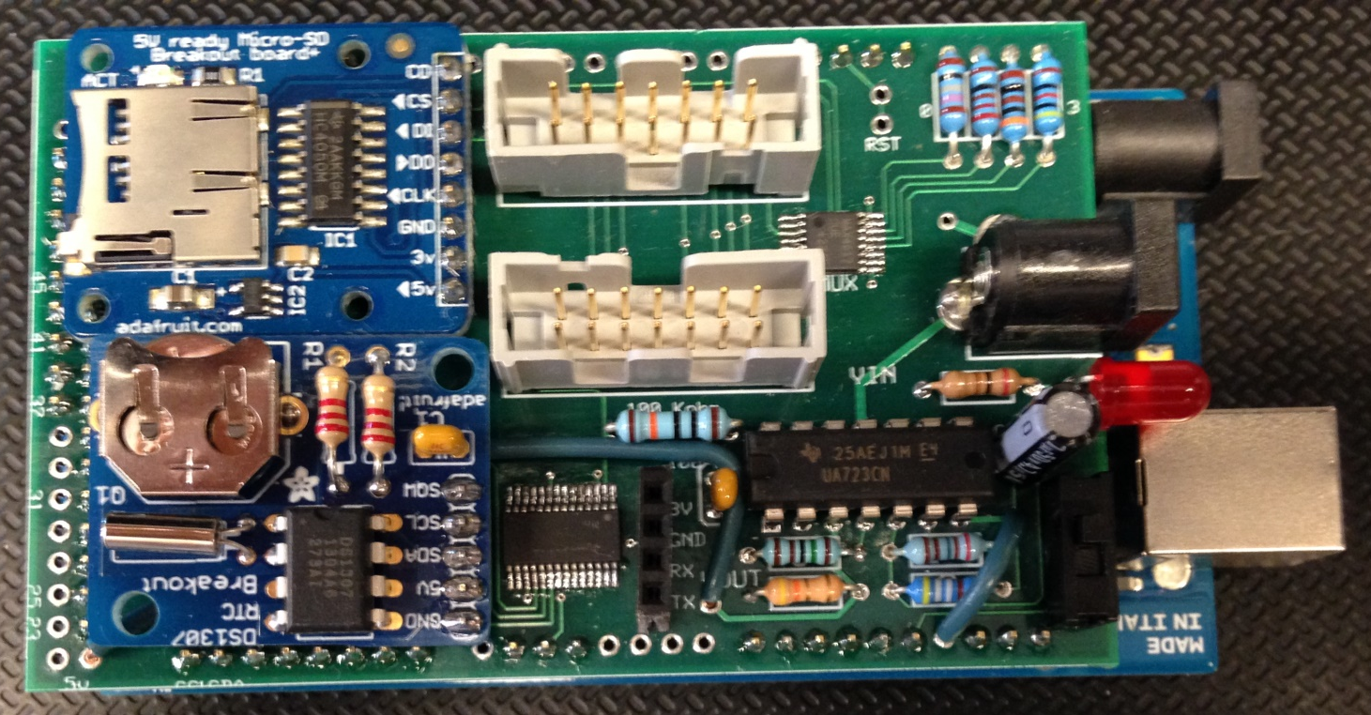
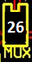
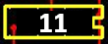
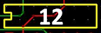
Side with one opening should be facing inward
For surface mount chips, dot should be oriented with opening seen on the schematic
For through-hole chips, slight indentation on the top of the chip should be oriented with opening on the schematic

Slide 3
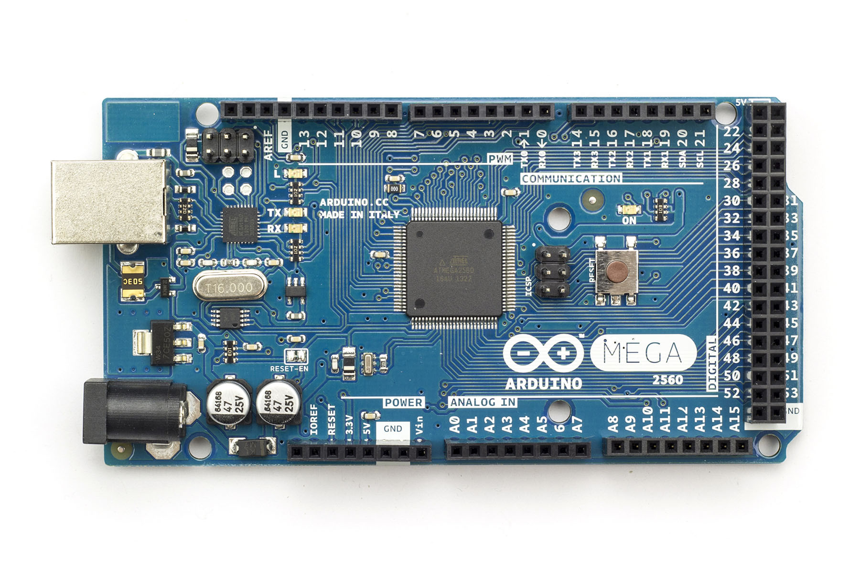

Slide 4
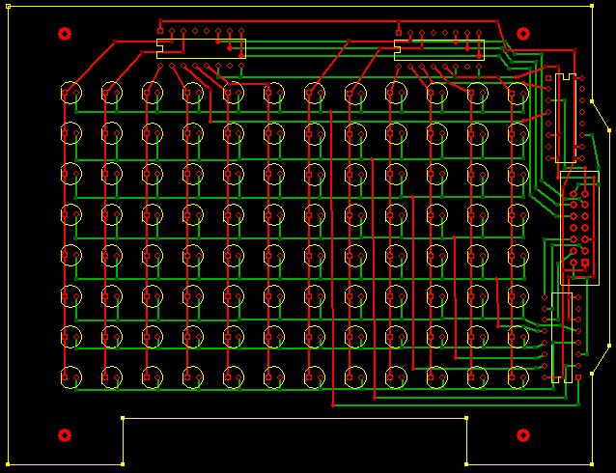
1
6
6
2/3
6
7
6

Slide 5
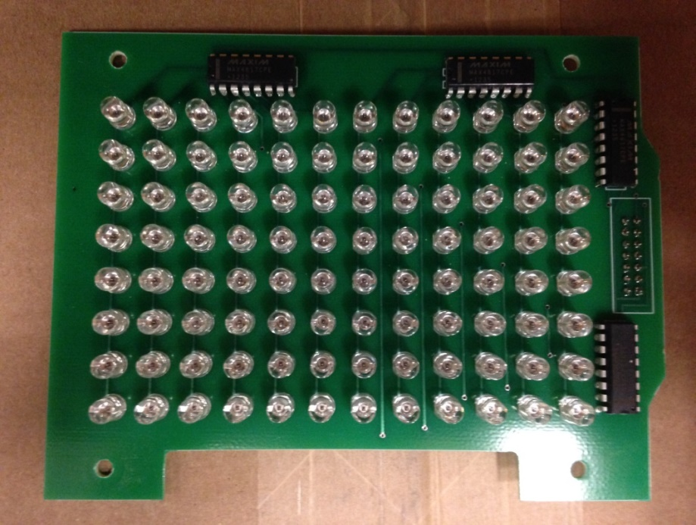
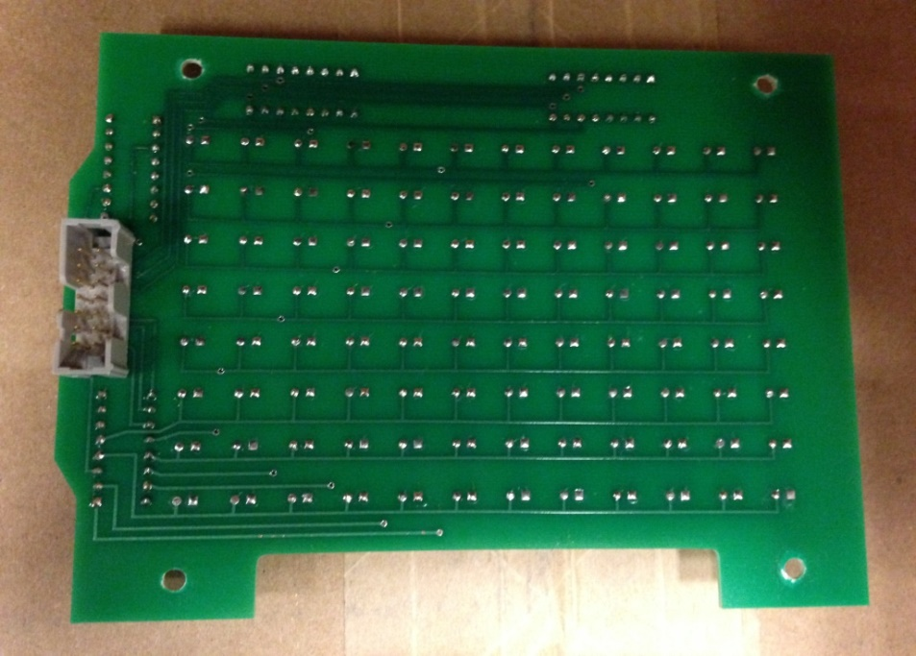
Emitters
Front
Back
Multiplexers are facing outward.
LEDs should be placed with the flat side facing the left and should be flush with the PCB.
Part 7: Side with one opening should be facing outward.

Slide 6
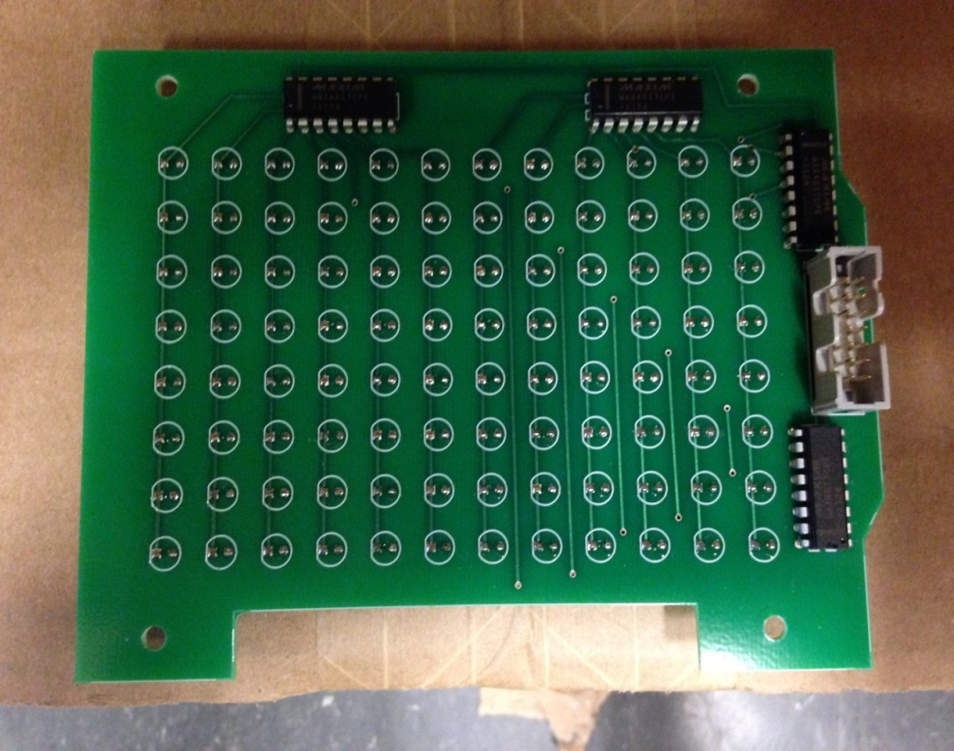
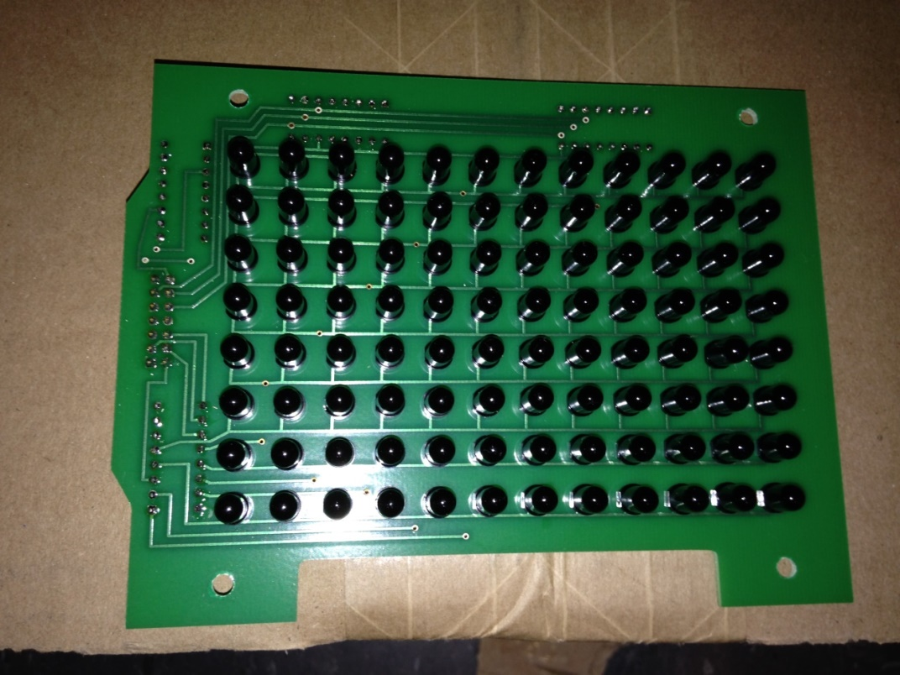
Front
Back
Multiplexers are facing outward.
Part 7: Side with one opening should be facing outward.
LEDs should be placed with the flat side facing to the left and should be flush with the PCB.

Slide 7
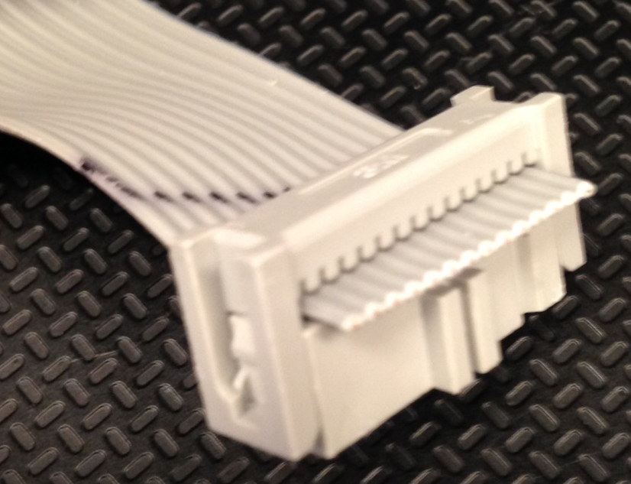

Slide 8
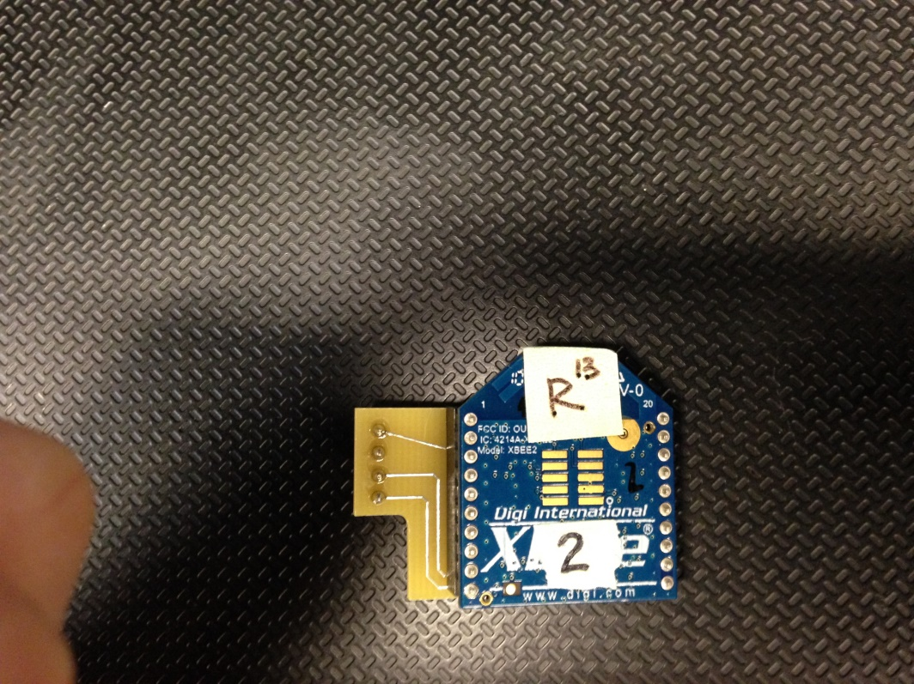

Slide 9
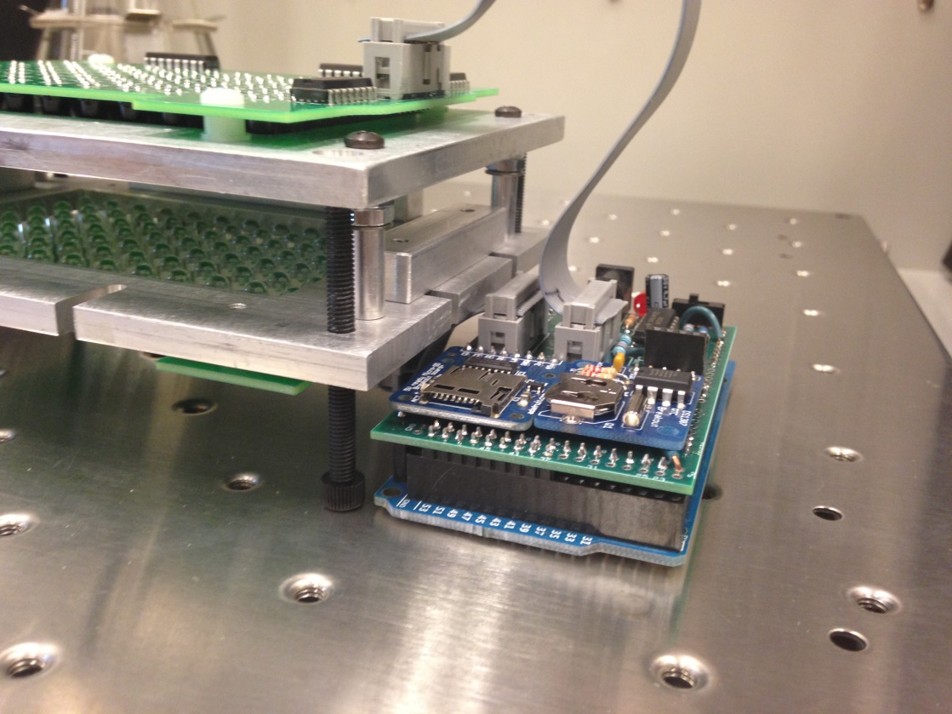

Slide 10
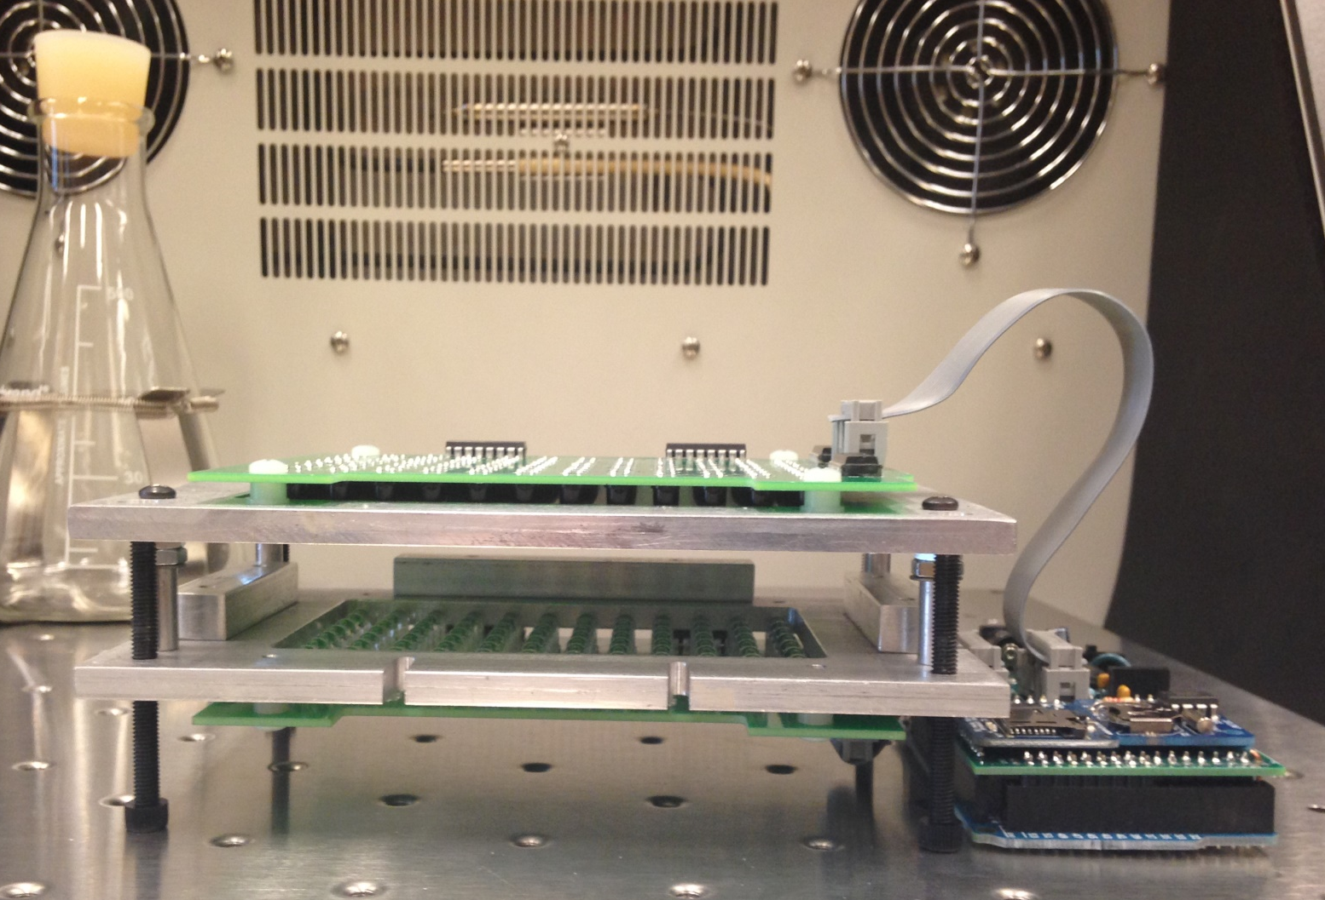

Slide 11
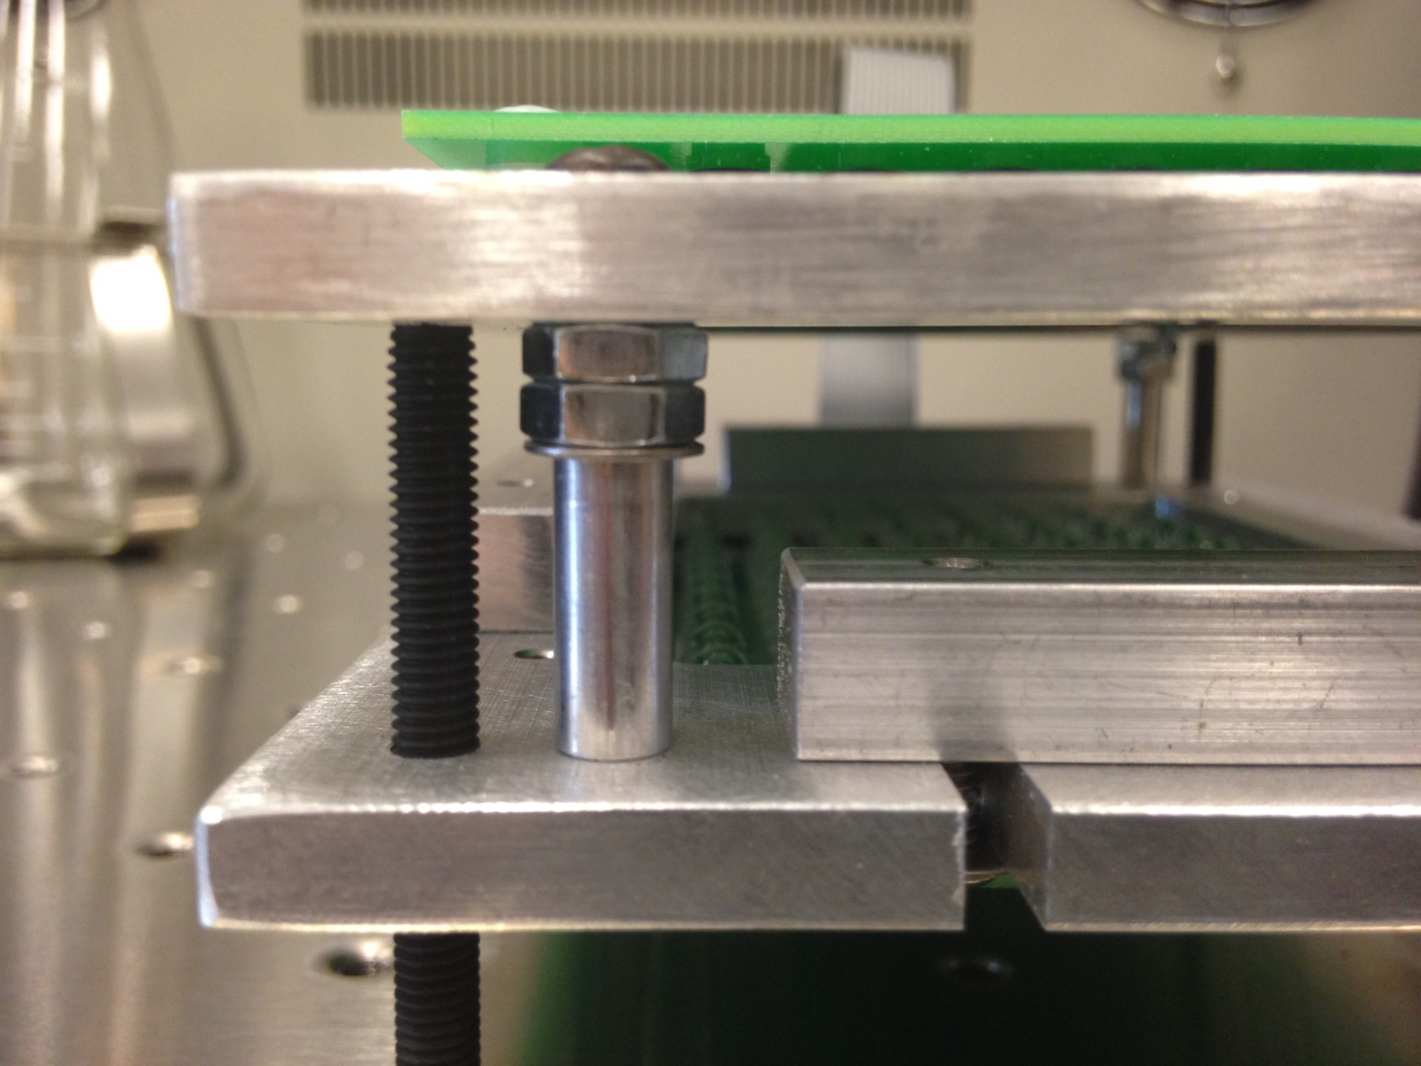

Slide 12
